Slide 1
Gold standard of evidence: Randomized Controlled Trial 101
Thuy Nguyen
15/10/2023

Slide 2
Scientific Method Review: Algorithm
Identify the research question
Identify the hypothesis
Identify the study design
Observations
Conclusions
Inferences

Slide 3
Scientific Method Review: Algorithm
Identify the research question
What’s the independent variable and effect dependent variable?
Key words/phrases: cause and effect, before and after
Identify the hypothesis
Identify the study design
Observations
Conclusions
Inferences

Slide 4
Scientific Method Review: Algorithm
Identify the research question
Identify the hypothesis
What does the researcher expect to find?
Key words/phrases: if/then statements, predict, anticipate
Identify the study design
Observations
Conclusions
Inferences

Slide 5
Scientific Method Review: Algorithm
Identify the research question
Identify the hypothesis
Identify the study design
What's the group we're comparing everything to?
Which group is getting the treatment?
What things are staying the same during the experiment?
How many times are we doing the experiment to make sure our results are reliable?
Key words/phrases: different, same/identical
Observations
Conclusions
Inferences

Slide 6
Scientific Method Review: Algorithm
Identify the research question
Identify the hypothesis
Identify the study design
Observations
What do the researchers learn from the trials?
Conclusions
Inferences

Slide 7
Scientific Method Review: Algorithm
Identify the research question
Identify the hypothesis
Identify the study design
Observations
Conclusions
Do the observations align with the hypothesis?
Inferences

Slide 8
Scientific Method Review: Algorithm
Identify the research question
Identify the hypothesis
Identify the study design
Observations
Conclusions
Inferences
How do the researchers apply their knowledge to make sense of what they observe?

Slide 9
What is the effect of exercising on health?
Independent variable:
Dependent variable:

Slide 10
What is the effect of exercising on health?
Independent variable: whether someone exercises or not
Dependent variable:

Slide 11
What is the effect of exercising on health?
Independent variable: whether someone exercises or not
Dependent variable: cholesterol levels
How much time per week does someone spend exercising?
Blood pressure? Resting heart rate? Mobility?
Many ways to define
the independent and dependent variables!

Slide 12
What is the effect of exercising on health?
Recruit participants

Slide 13
What is the effect of exercising on health?
Ask about their exercise habits
Person does not exercise
Person exercises

Slide 14
What is the effect of exercising on health?
Cholesterol levels
Exercising raises cholesterol levels???
Person does not exercise
Person exercises
Exercise
Don’t exercise
Notes:
What is the graph showing?
Does exercising raise cholesterol levels? Why might we be seeing such contradictory results? (Hint: bias)

Slide 15
Bias: systematic error in sampling or testing
Exercising raises cholesterol levels???
Cholesterol levels
A potential bias
Unhealthy individuals may be more motivated to exercise
Exercise
Don’t exercise
Notes:
What is the graph showing?
Does exercising raise cholesterol levels? Why might we be seeing such contradictory results? (Hint: bias)

Slide 16
Solution: Fair Experiment
How would you design a fair experiment?
Treatment: Daily cardio exercises for 30 mins
Control: Light daily stretching exercises for 10 mins
Why might we want to provide the control group with light stretching exercises?

Slide 17
Randomized Controlled Trial

Slide 18
Randomized Controlled Trial
Random assignment!

Slide 19
Before Treatment: No observed differences
Before Treatment
Cholesterol levels
If the randomization is done correctly, baseline cholesterol levels should be similar prior to treatment
Control/Baseline group
Treatment/Experimental group
Control group
Treatment group

Slide 20
After Treatment: Effect of Daily Exercise
After Treatment
Cholesterol levels
Treatment Effect
Control/Baseline group
Treatment/Experimental group
Control group
Treatment group

Slide 21
Takeaways
Bias could produce misleading and counterintuitive findings
Randomization at the start of the study ensures group comparability, allowing for a fair comparison
Defining the independent and dependent variables are at the heart of study design
Many considerations (e.g., ethical concerns, cognitive biases, and others) come into play when determining what the treatment and control groups receive

Slide 22
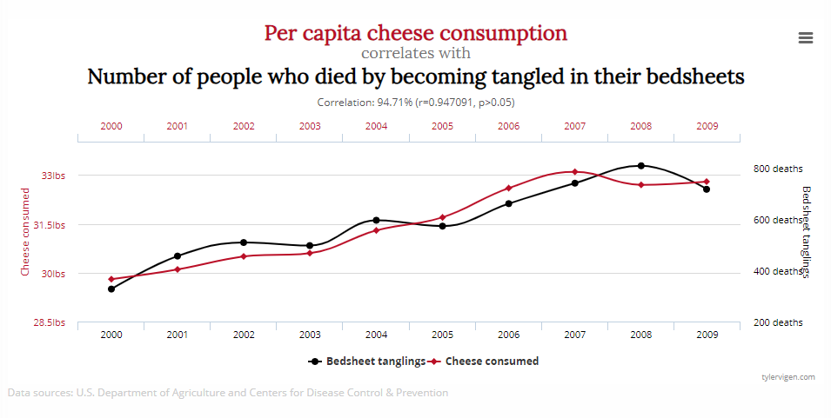
Spurious correlation
https://web.archive.org/web/20150514142734/http://tylervigen.com/spurious-correlations

Slide 23
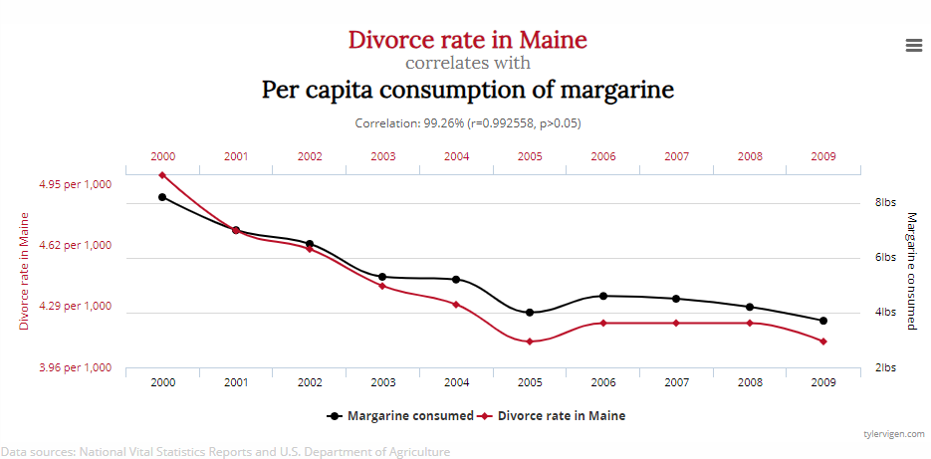
Spurious correlation
https://web.archive.org/web/20150514142734/http://tylervigen.com/spurious-correlations

Slide 24
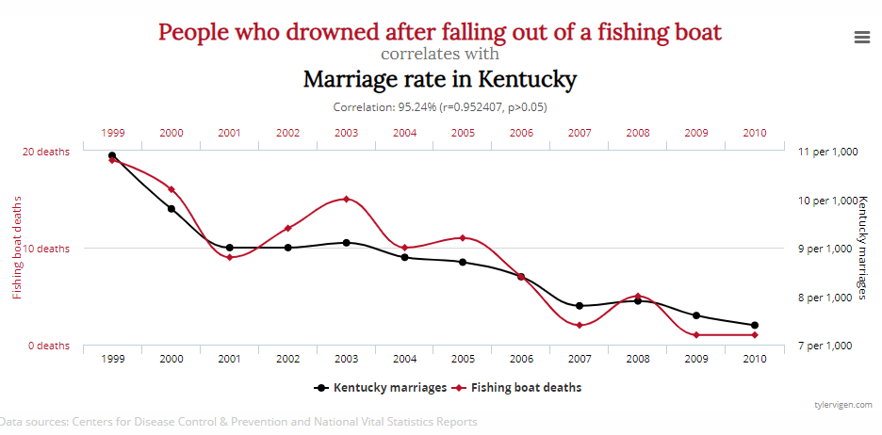
Spurious correlation
https://web.archive.org/web/20150514142734/http://tylervigen.com/spurious-correlations

